Slide 1


Local SDI Dehradun
3.2(a):Technology and Standards for Geospatial Workflow
Course details:
M.Tech. in RS and GIS
Semester II
Module III
Presented to:
Kapil Oberai sir
Scientist SF
GID, IIRS, ISRO
Presented by:
Advaith C A (PRSD)
Sudikin Pramanik (GID)

Slide 2



CONTENT
1
Introduction
2
Objectives
3
Materials used
4
Methodology
5
Result and discussion
6
Acknowledgement
7
References

Slide 3
1
Introduction
We discuss in brief about SDI
Part one

Slide 4
SDI is framework for
Effective collection
Integration
Discovery
Sharing
Delivery
Utilization
The important points that needs to be kept in mind

Slide 5
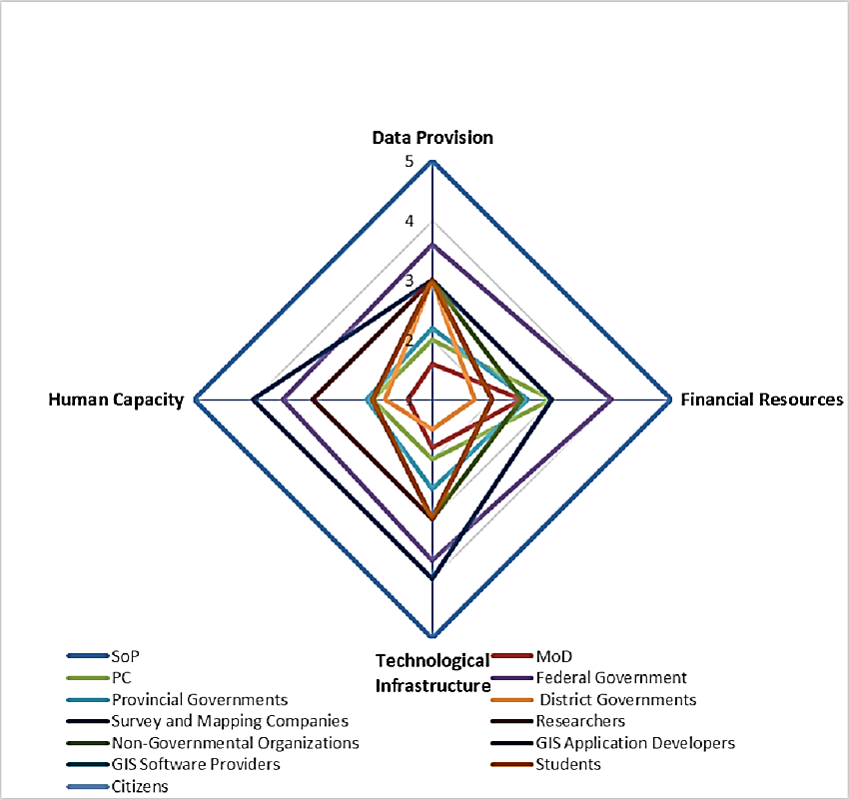
Resulting in
+
Awareness
Cooperation
How?
Whom?
There will be increased awareness in the use of geospatial data for the global community
Cooperation between decision-makers and stake-holders

Slide 6
Fig: National spatial data infrastructure stake holder diagram of Pakistan

Slide 7
Benefits of SDI
01
02
03
04
Removes duplication
Improves quality
Reduces cost
Establishes partnership
It reduces duplication by centralized data repository, standardization and interoperability
It maintains quality by producing comprehensive metadata, regular updates and maintenance and various quality control measures.
Elimination of redundant data collection, efficient resource allocation and reduced IT resource infrastructure cost.
It provides policy and legal framework, data sharing agreements, collaborative platforms and tools, governance structures and community building
PPT下载 http://www.1ppt.com/xiazai/

Slide 8
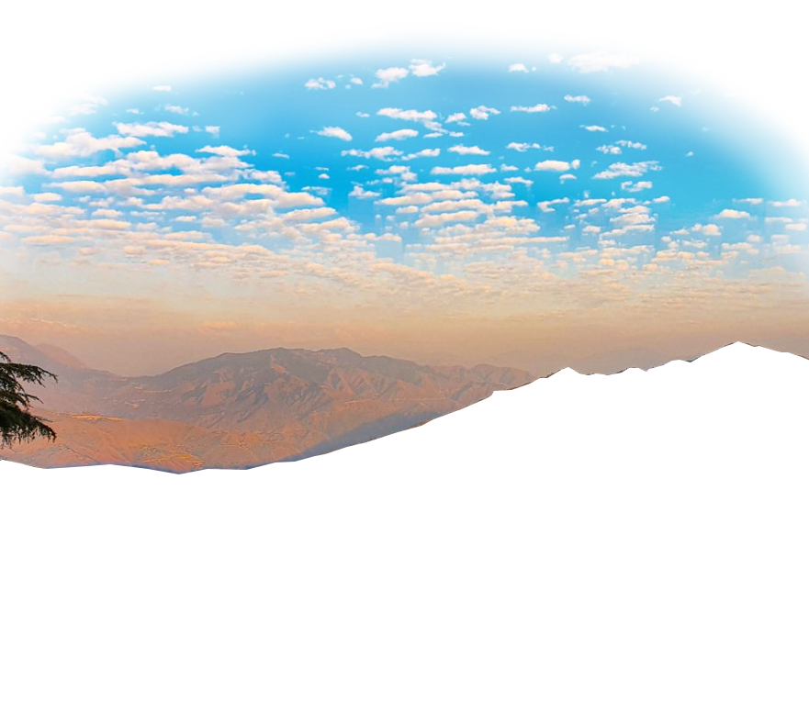
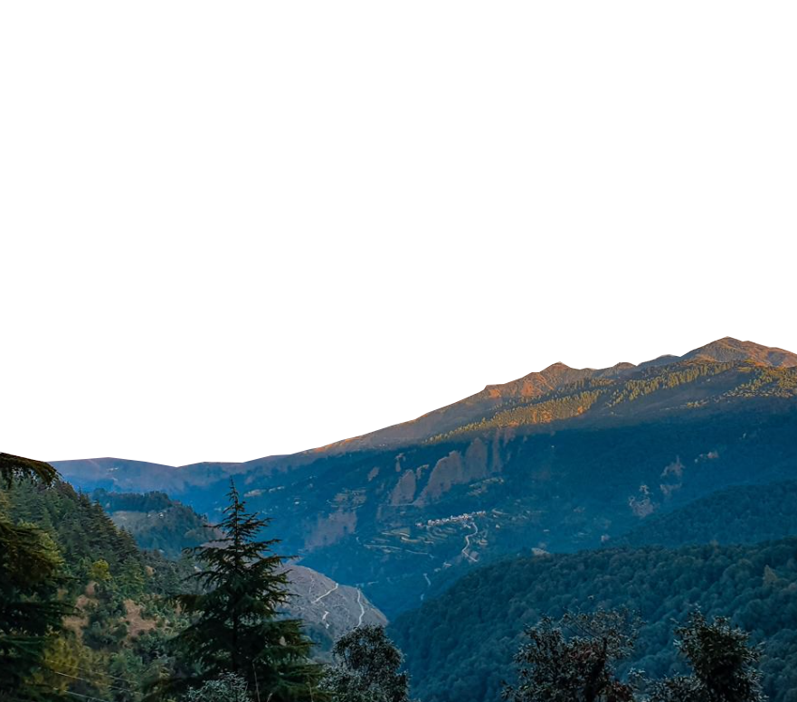
SDI of Dehradun
No active SDI
Creating and SDI for Dehradun district is necessary as it serves as an educational hub, tourism gateway, business center, administrative significance, military presence and good climatic conditions. The following things must be kept in mind while preparing an SDI.
Fig: Chakrata ©Aashu Punetha
Standards
Data
Resources
Various OGC and metadata standards
Multisource and multi type data
Various softwares and good hardwares

Slide 9
02
Objectives
This section describes what we want to do.
Part two

Slide 10





To create local SDI for Dehradun for services
WMTS and interoperability
WFS/WCS
User can see multiple data tiled over one another.
Web feature service for retrieval and manipulation of geographic features
Data download
WMS
WPS
User can download data already uploaded in the server
Web map service for generating georeferenced map images
Web processing service geospatial processes

Slide 11
03
Materials used
Listing all the resources used
Part three

Slide 12





Hardware
2
Separate computers were used
PC 1
PC 2
AMD Ryzen 7 5800H with Radeon Graphics 3.20 GHz
Nvidia RTX 3060 Laptop GPU
16 GB RAM
1 TB SSD (with roughly 260 GB Free space)
Intel Core i9 10850K CPU 20cores at 3.60 GHz
Intel UHD Graphics (Integrated)
16 GB RAM
250 GB SSD + 1TB HDD

Slide 13













Software used
Some softwares are proprietary some are open source
Various softwares are used

Slide 15

Windows 11
Java 8
Geonetwork
Elastic search
Primary operating system
Programming environment
Metadata cataloguing system
Searching the catalogue
Geoserver
Apache tomcat
Camunda
Draw io
For web processing
Web server
BPMN diagram
UML diagrams
Overleaf
TMUX
Adobe photoshop
VS code
To create reports in LaTeX
Terminal multiplexer
Graphics editing
Text editor

Slide 16

Data used
Data from various sources were used
• Survey of India Shapefile for Dehradun Villages (Product Code OVSF/-/10).
• LISS-3 and LISS-4 Earth Observation Multi-spectral Data from Bhoonidhi (GeoTIFF format available)
• 20 different types of Dehradun district shape files of position data
• 10 different types of raster DEM of Dehradun district
• Landsat thermal raster data
• Hydro-Shed data prepared by Bernhard Lenard
• Total monthly precipitation netCDF4 data 2023
• Total relative humidity monthly netCDF4 data 2023
• Sentinel 2 LULC data
• Global canopy height
• Geology 2M, geomorphology 250K, geochemistry from Bhukosh
The idea was to create an SDI with most of the data that can be found.

Slide 17
4
Methodology
We discuss the methodology and workflow of the SDI
Part four

Slide 18
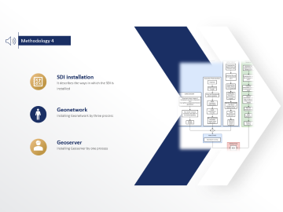



Methodology contents
5
Diagrams are there

Slide 19
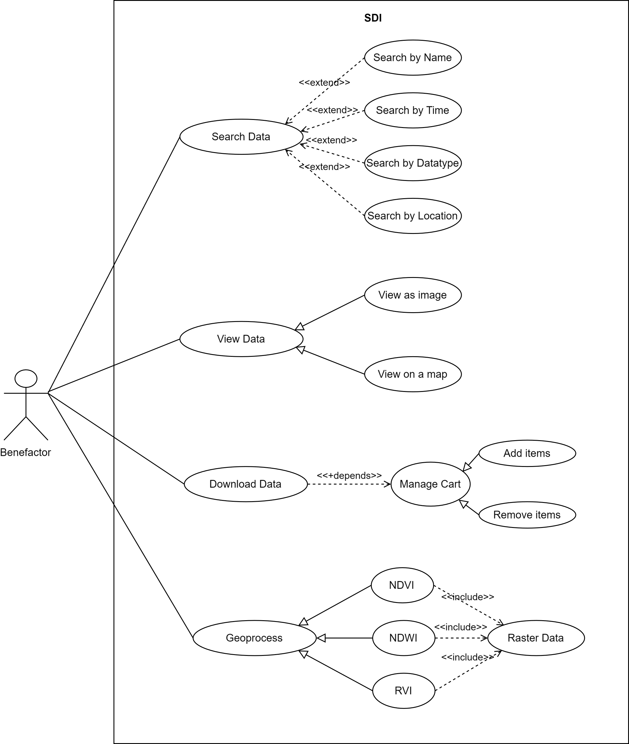



Methodology 1
Use case UML diagram
It tells you how users interact with the system to get their work done.
Primary actor
The user is the primary actor .
Secondary actor
There are no secondary actors.

Slide 21
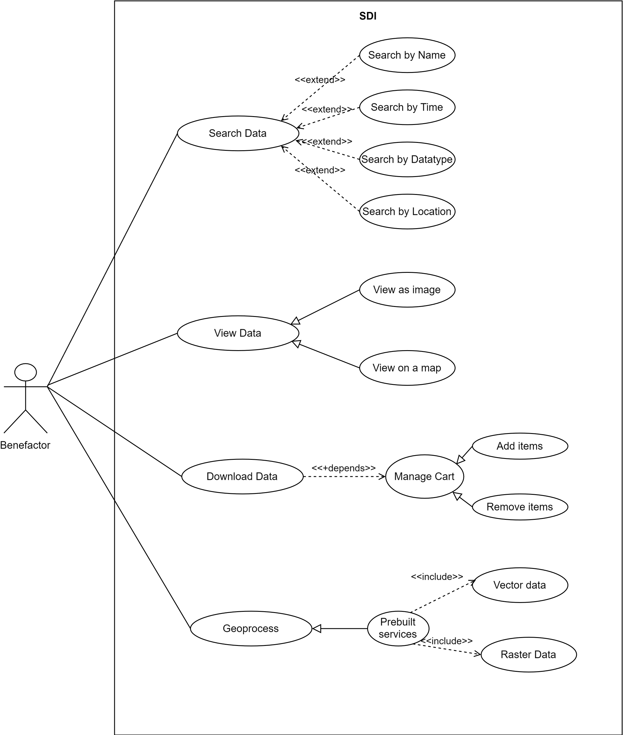

Slide 29
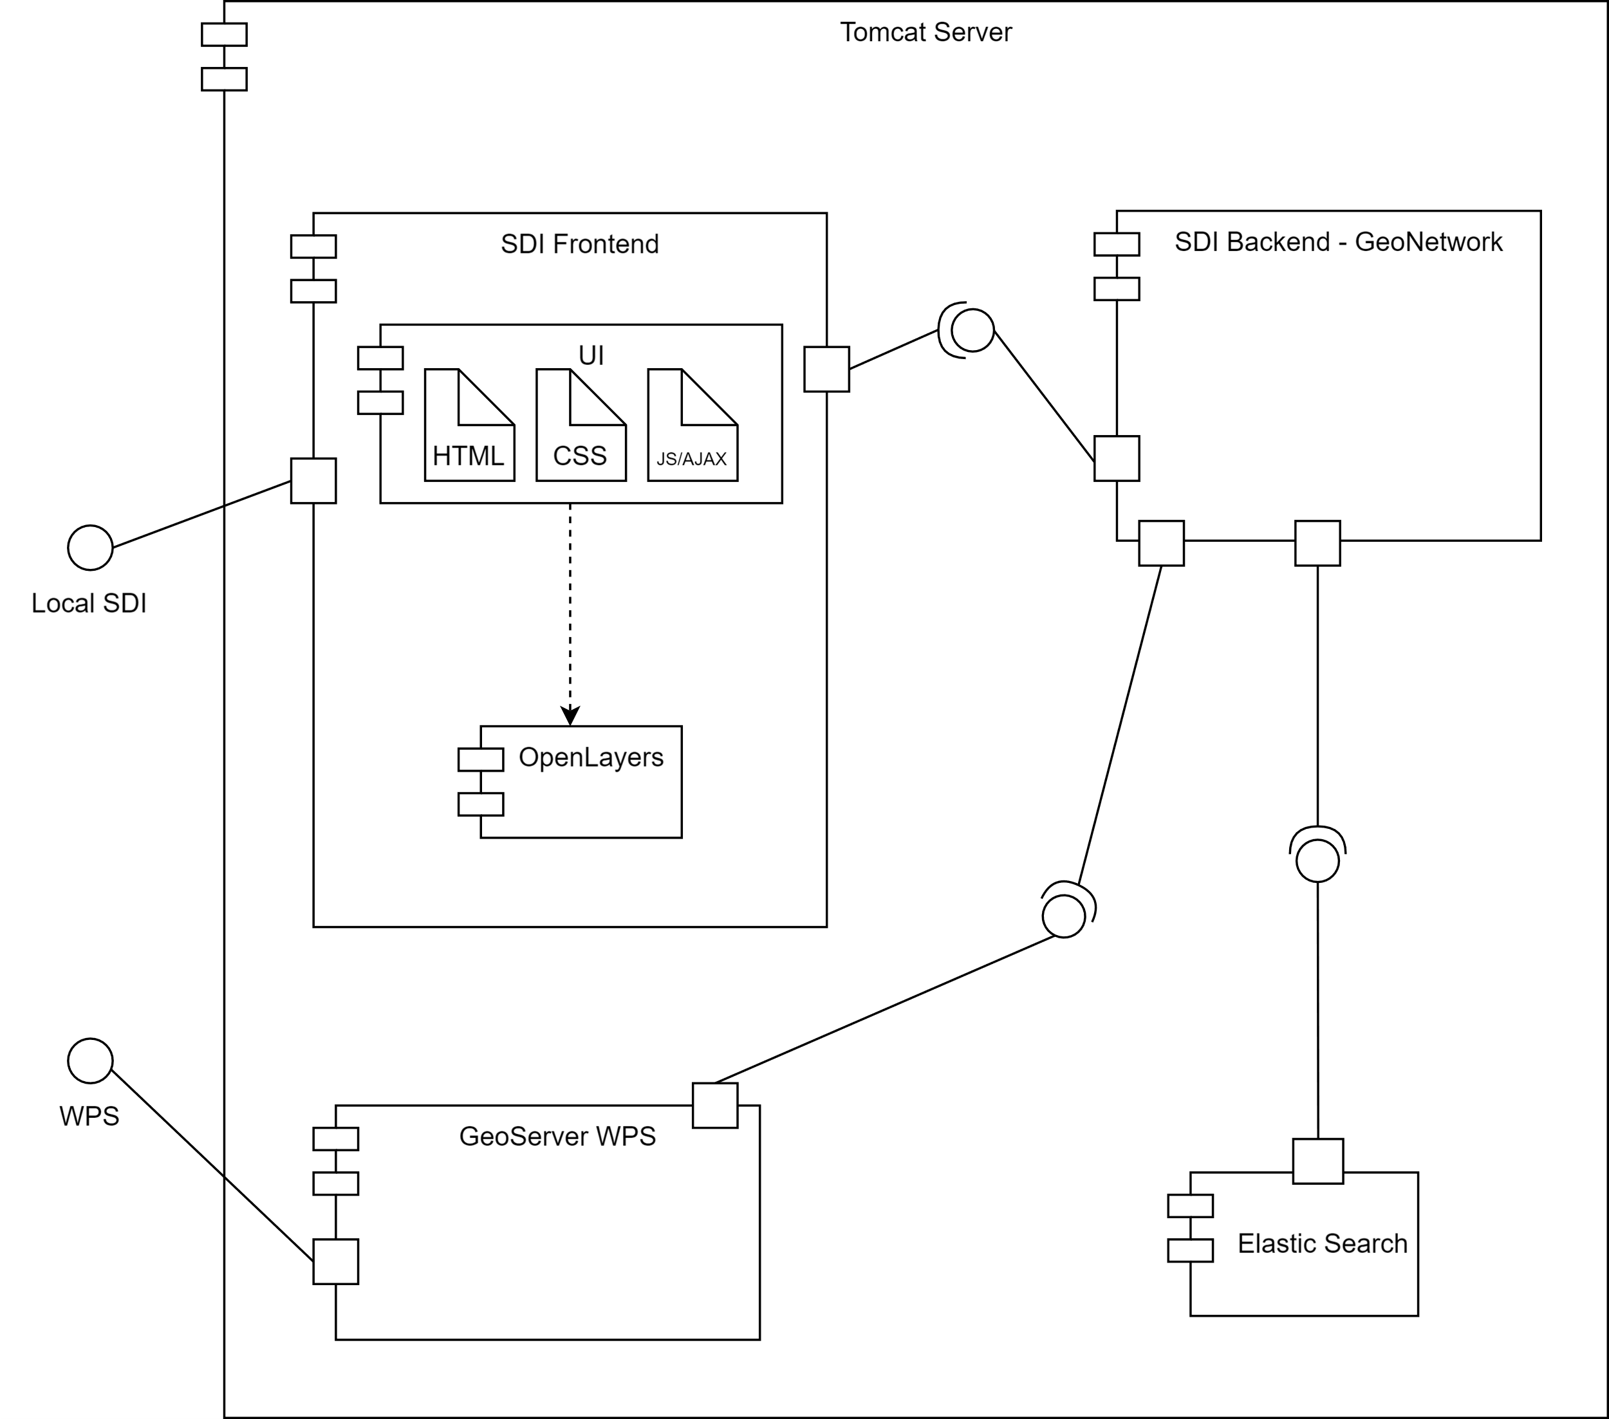
Methodology 2
Component UML diagram
It tells you how users interact with the system to get their work done.
Primary component
Tomcat server
Dependencies
Front end, back end, elastic search, geo server

Slide 35
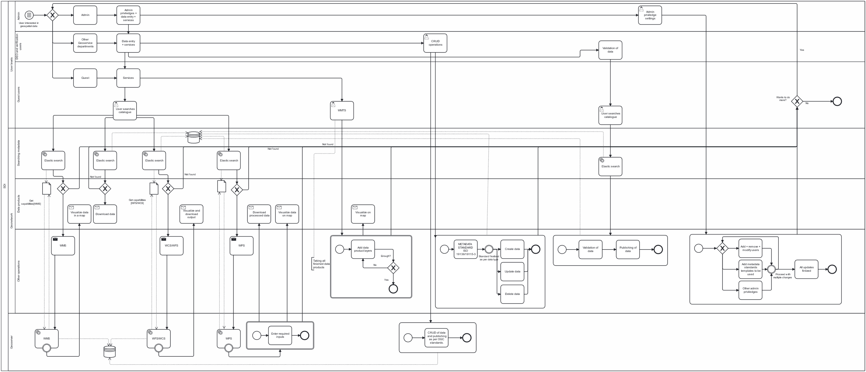
Methodology 3
BPMN workflow diagram
It tells you how users interact with the system to get their work done.
Start
Conditional users like admin, DEO and guests
Sections
User access, Geonetwork, Geoserver

Slide 50
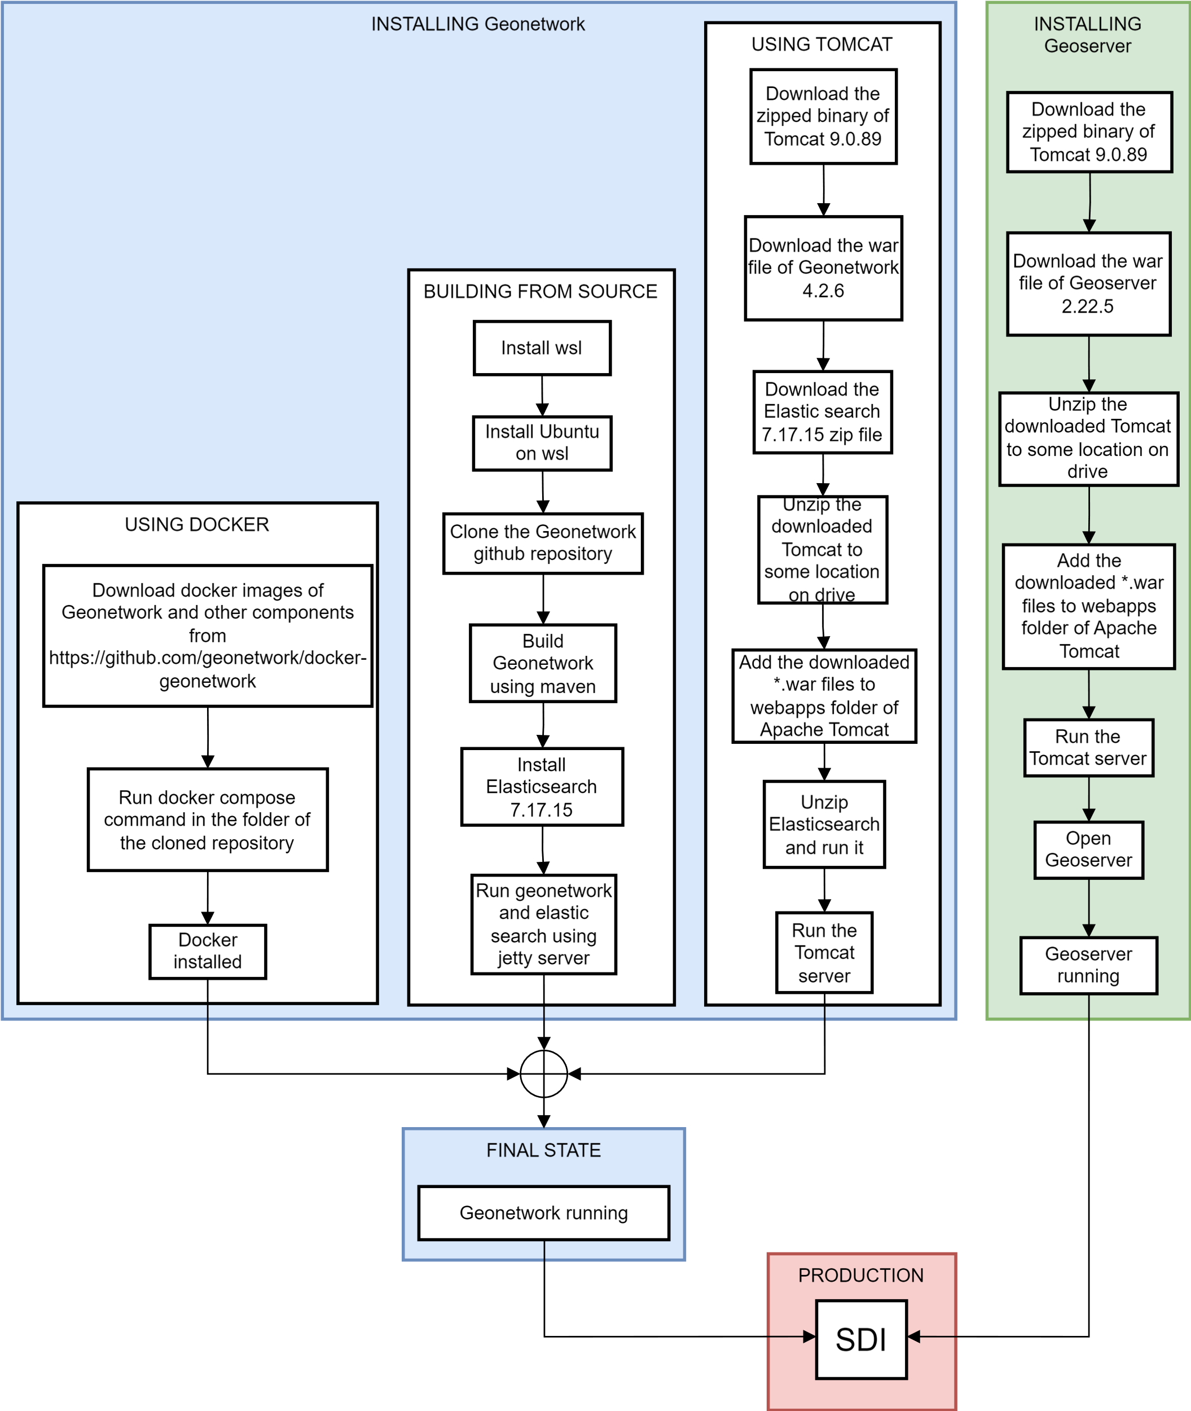
Methodology 4
SDI installation
It describes the ways in which the SDI is installled
Geonetwork
Installing Geonetwork by three process
Geoserver
Installing Geoserver by one process

Slide 51



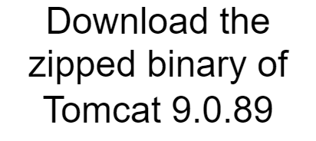
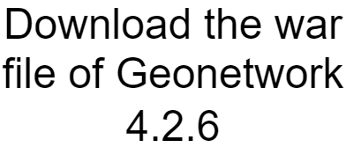
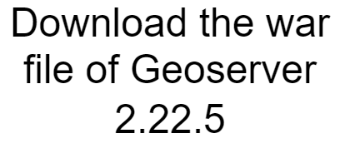



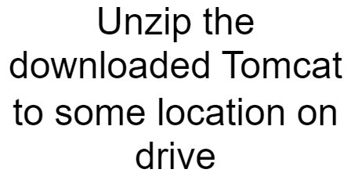
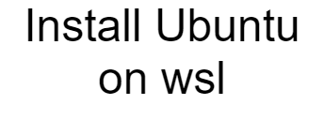
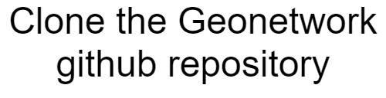
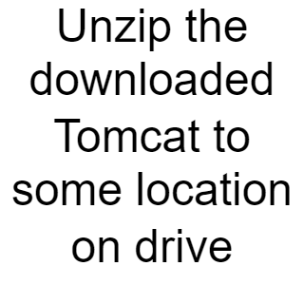
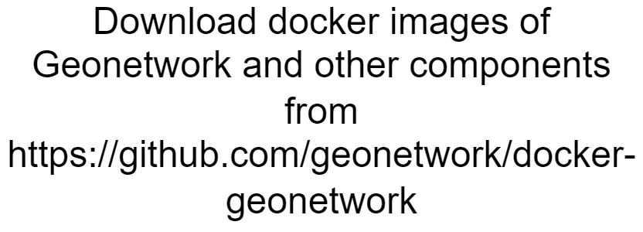
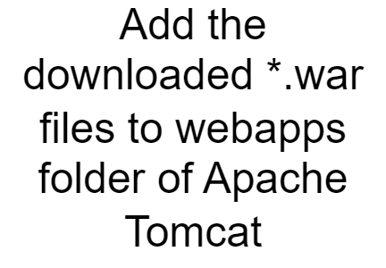
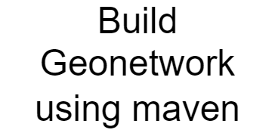
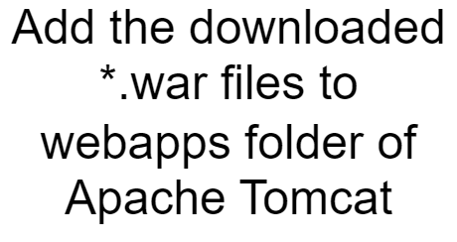


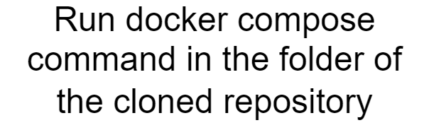
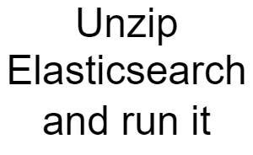
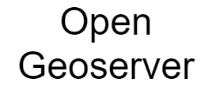
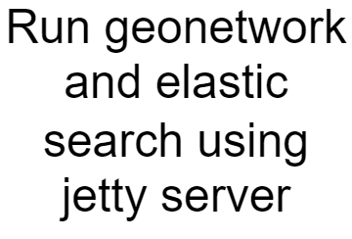

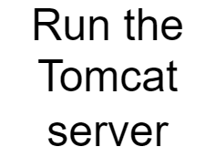
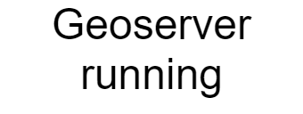




Slide 52
5
Result and discussion
The results are discussed here
Part five

Slide 53

Metadata
Geospatial metadata standard
Metadata data standards are ISO 19115, FGDC(Federal Geographic Data Committee) and the
International Standard Dublin core
ISO 19115
The most accepted International standard.
ISO 19139
XML schema of 19115.It provides WMS only.
ISO 19115-3
We have used this standard a it clubs all OGC standards.

Slide 54
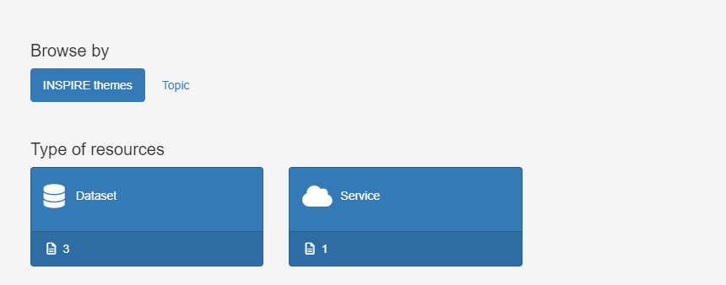
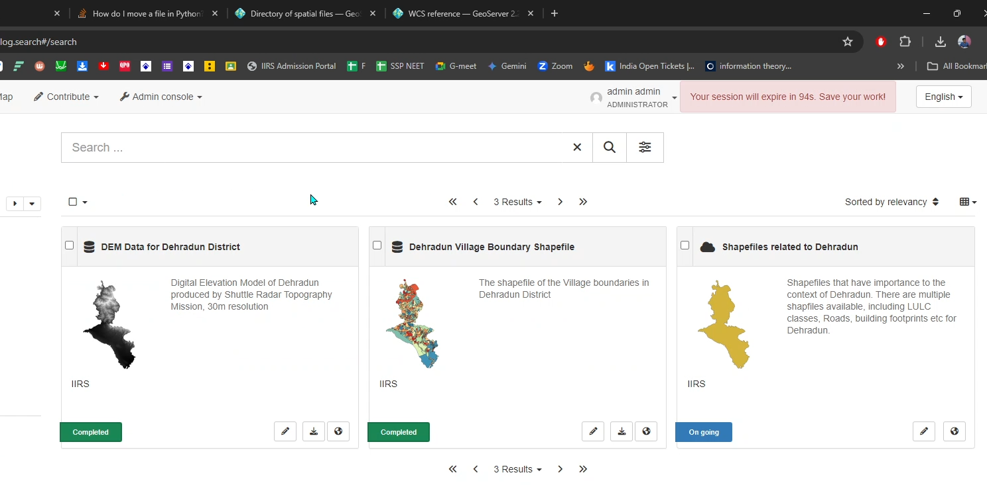
Result 1
SEARCH RESULT IN GEONETWORK
It displays the image thumbnails
The result is based on the user access levels.
On clicking the search results more options of OGC come up.

Slide 56
Result 1
SEARCH RESULT IN GEONETWORK
It displays the image thumbnails
The result is based on the user access levels.
On clicking the search results more options of OGC come up.

Slide 58
Results 1
SEARCH RESULT IN GEONETWORK
It displays the image thumbnails
The result is based on the user access levels.
On clicking the search results more options of OGC come up.

Slide 59
Results 2
Geoserver
It is used to store data.
View and edit geospatial data.
Geoserver has many functions
We can create all the OGC services and link them.
It gives REST API.

Slide 60
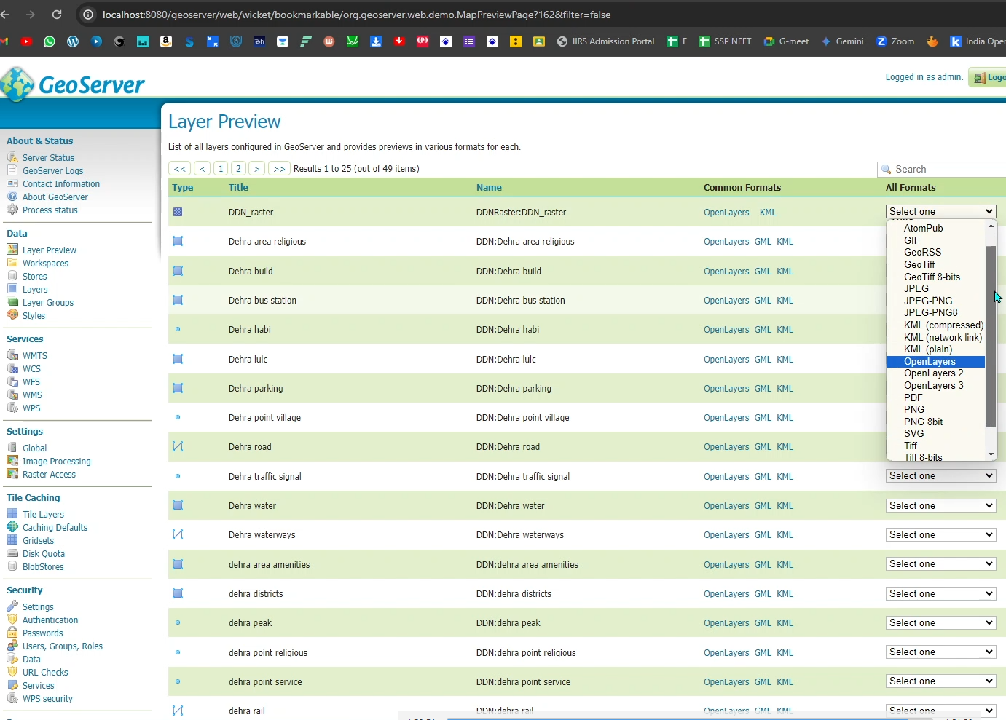
Result 2
Geospatial data
All contents uploaded in Geoserver are listed below
Vector data
Formats added are shapefiles
Raster data
Formats added are geoTIFF

Slide 62
6
Acknowledgement
Lets acknowledge the benefactors
Part five

Slide 63
Add title text
Mr. Kapil Oberoi
Avijnan Das
Nilkamal Konra
D
Scientist SF for constant guidance on everything.
M.Tech. MASD for data.
M.Tech. ASD for data
M.Tech.URSD for Turnitin plagiarism report.
Dr Kamal Pandey
Parthiv Narayan
Nilay Dey
Scientist SE for technological exploration
M.Tech. FED for data.
M.Tech WRD for data

Slide 64
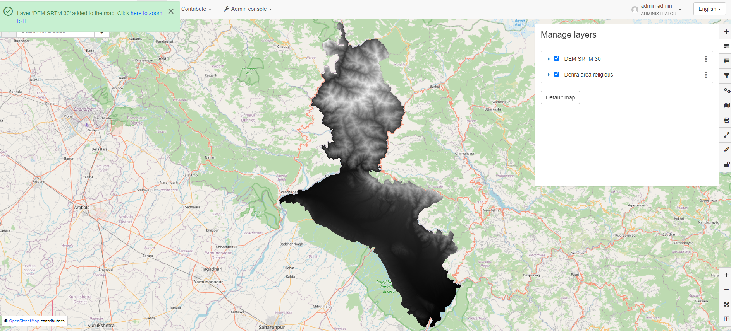
Result 3
WMS
Web map service or WMS serves geospatial images that are georeferenced.Some formats are given here
JPEG
PNG
GIF
PDF

Slide 66
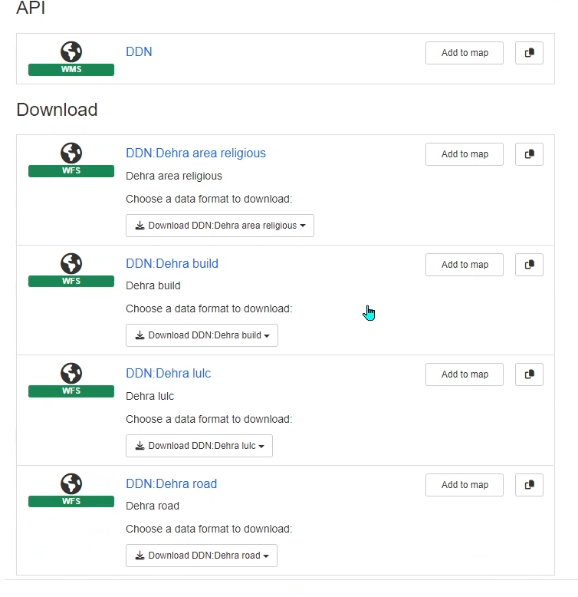
Result 3
WFS and WCS
WFS
WCS
Web Feature service for vectors.
Web coverage service for rasters.

Slide 67
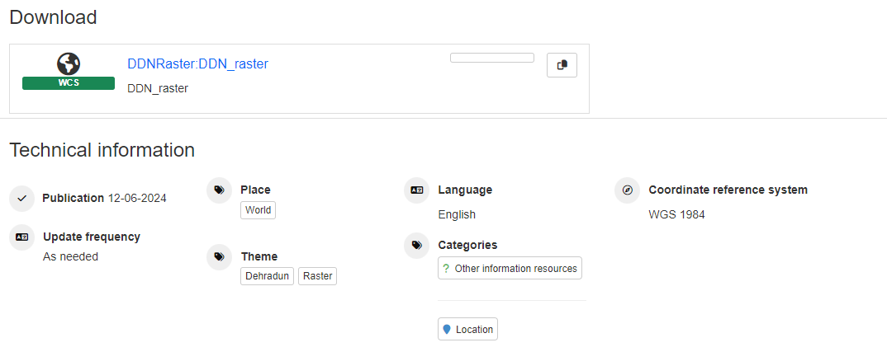
You can download the data by clicking and save it in your system.

Slide 68
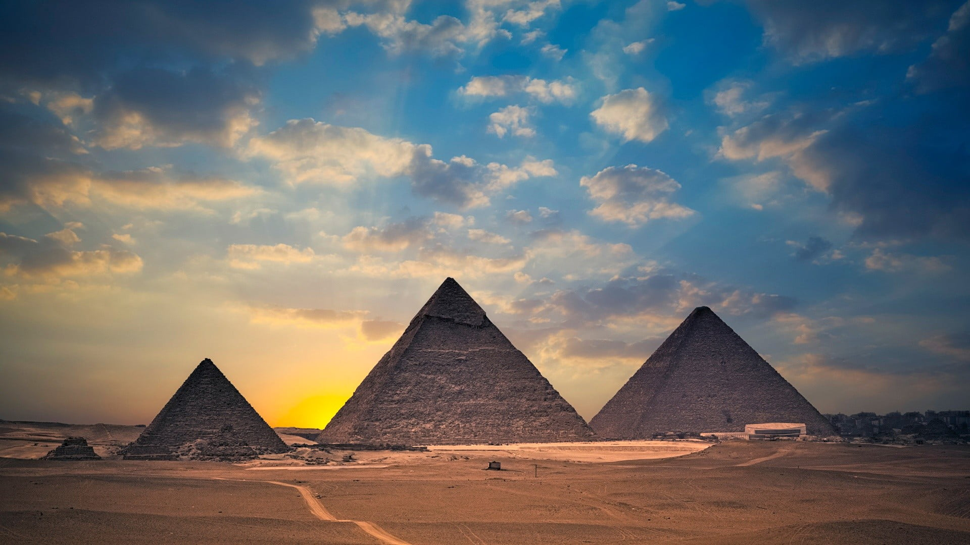
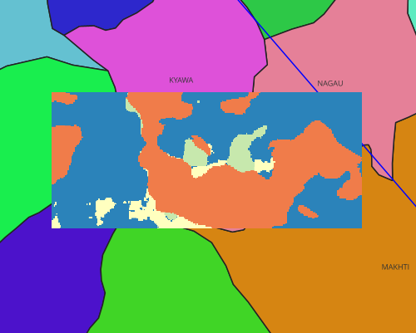
Result 4
WMTS
Web Map Tile Service is a tiling service designed by OGC standards that creates pyramid layers for the rendered image.We can see a lulc pyramid tile by side.

Slide 69
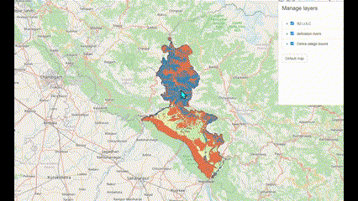

Slide 70
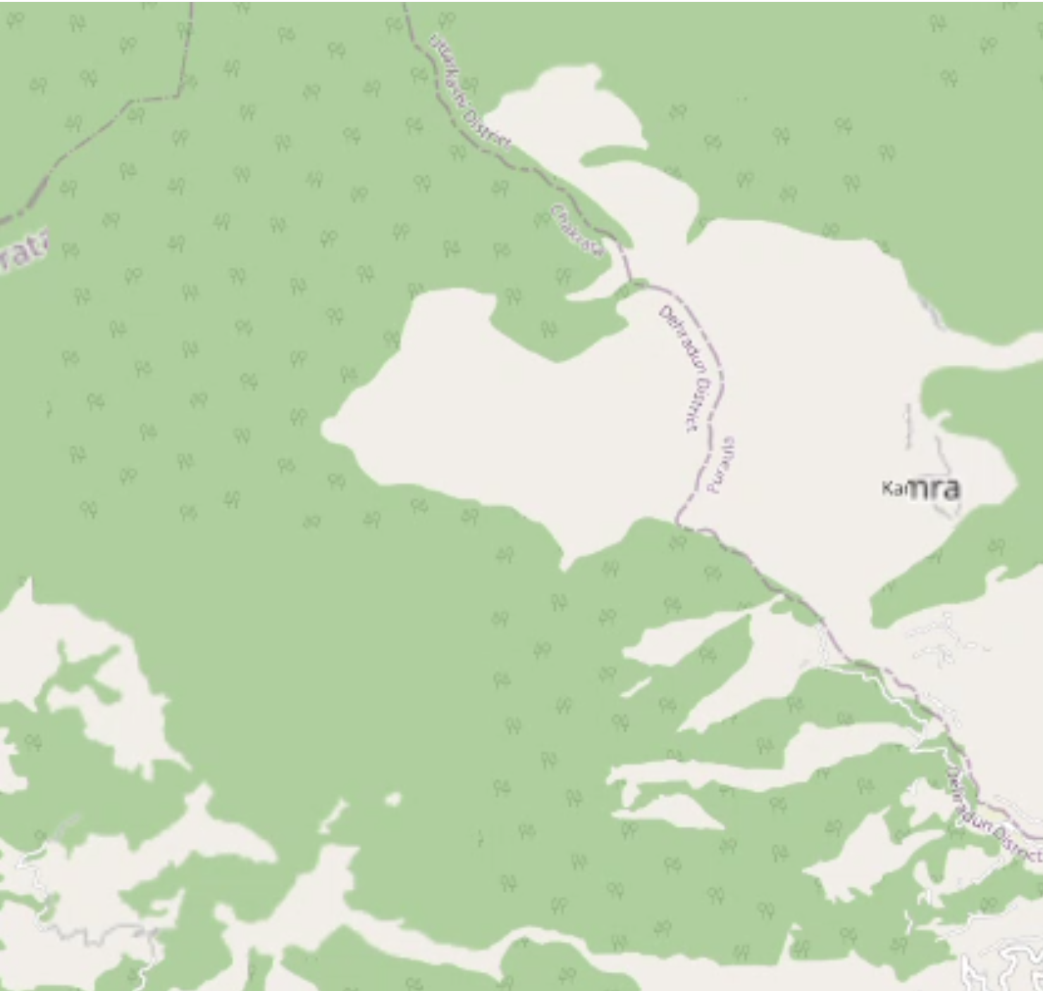
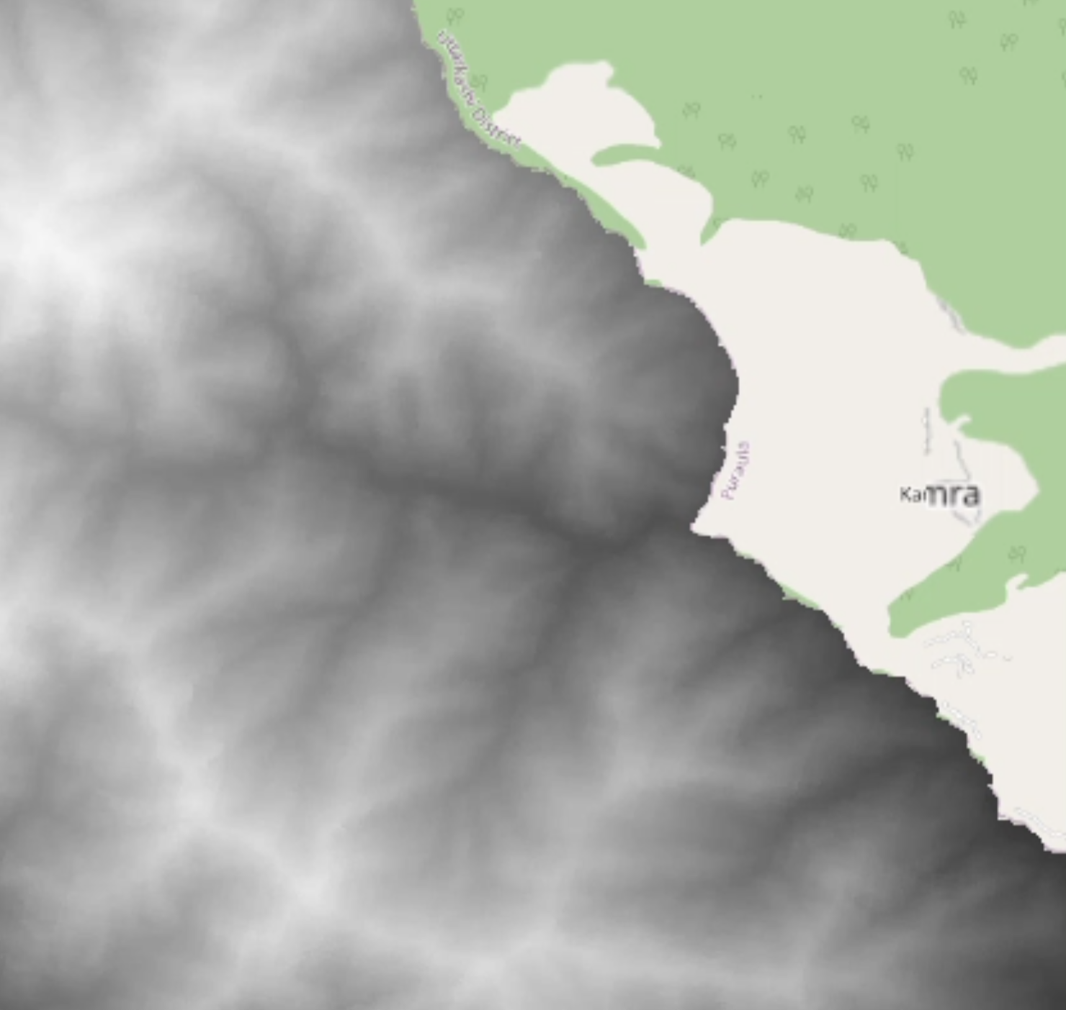
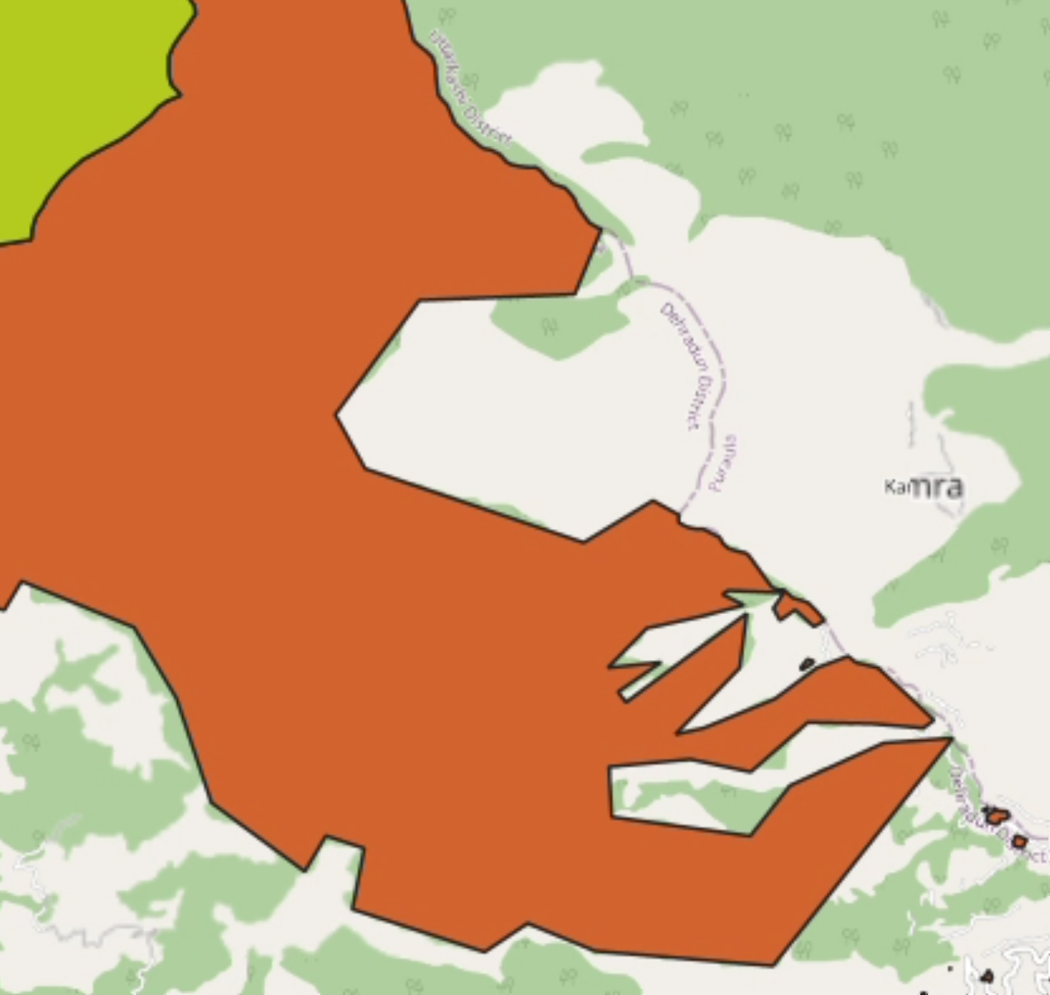
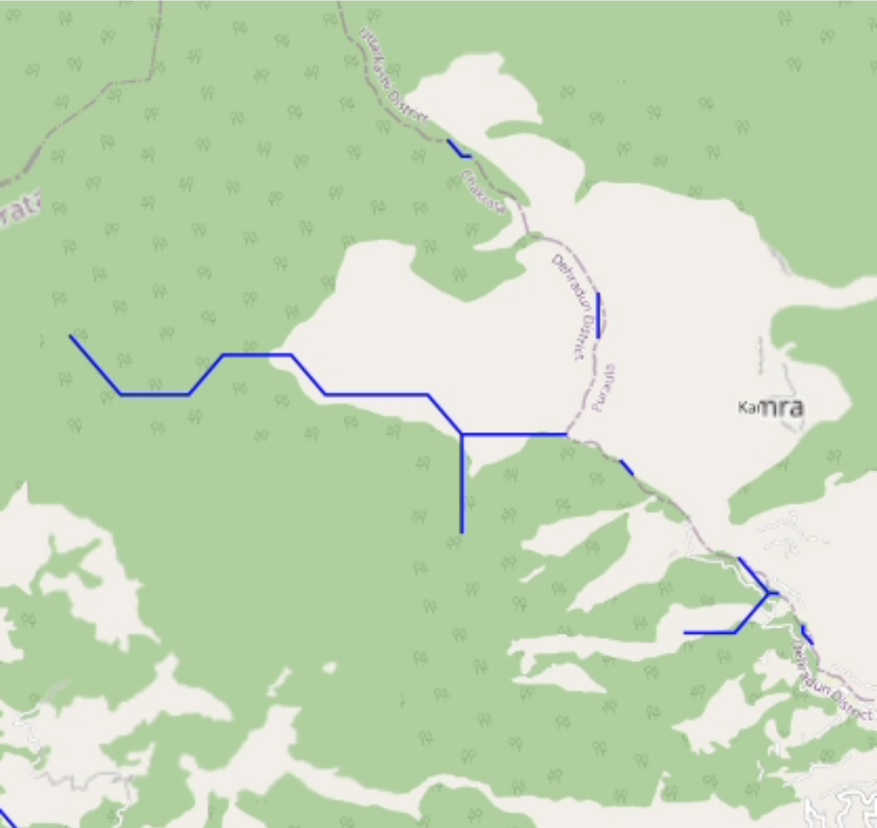
Result 5
Interoperability
Tile 1
WMS 2
WMS 3
WMS 4
Base OSM
Raster
Vector
Vector
Base layer
WMS 2
WMS 3
WMS 4
OSM is the default base layer.
We have used the SRTM 30m DEM image
We have put Dehradun LULC shape file image.
Dehradun hydroshed river network shapefile image.

Slide 71
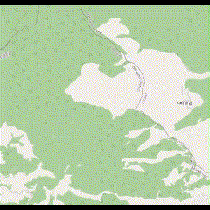

Slide 72
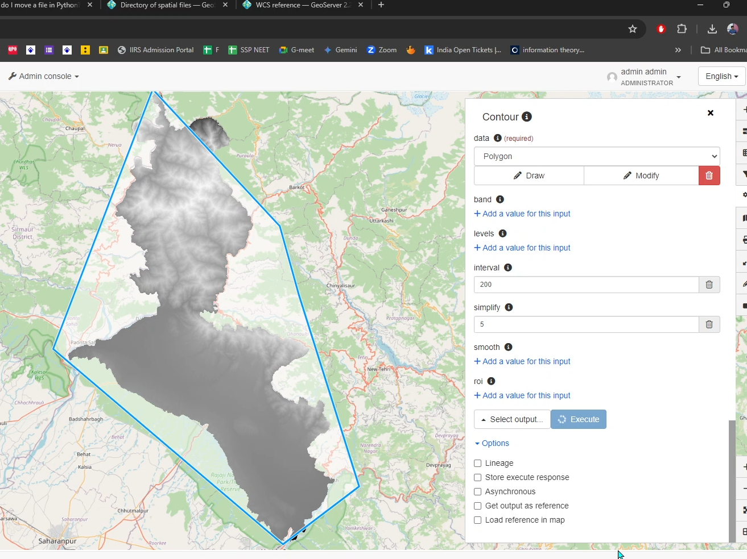
Result 6
Web Processing Service provides some geoprocess as a web service.
WPS

Slide 73
LOGO
05
Add title text
Click here to add content, content to match the title.
The part five

Slide 74


Add title text
Add title text
Add title text
25%
Add title text
45%
Add title text
30%
Click here to add content, content to match the title.

Slide 75
Add title text
Click here to add content, content to match the title.
STEP
STEP
Click here to add content, content to match the title.
02
03
STEP
STEP
01
04
Click here to add content, content to match the title.
Click here to add content, content to match the title.

Slide 76
Add title text
Add title text
Add title text
Click here to add content, content to match the title.
Click here to add content, content to match the title.
Add title text
Add title text
Add title text
Click here to add content, content to match the title.
Click here to add content, content to match the title.
Click here to add content, content to match the title.

Slide 77
Q&A time
Teachers, please raise my subject
valuable opinion!

Slide 78
THANKS
Thanks to my alma mater for providing valuable learning and practice opportunities!
Thanks to my mentor team!
Thank you students for your support and help!
Thank you all reviewers!

Slide 79
LOGO
THANK YOU
XXX Academy
Respondent:
Instructor:

